Slide 1

Housing Price Prediction
Presented by: Deepika

Slide 2
Outline
Introduction
Problem Statement
Problem Understanding
What Is Housing Price Prediction?
Importance of Housing Price Prediction
Benefits of Housing Price Prediction
Exploratory Data Analysis
Map for checking the correlation:
Visualizations
Data Inputs- Logic- Output Relationships
Model Building
Hyper Parameter Tuning
Final modal
Conclusion

Slide 3
Introduction
Houses are one of the necessary needs of every person around the globe. Therefore, the housing and real estate market is one of the markets that is one of the major contributors to the world’s economy.
It is a very large market and various companies are working in the domain. Data science comes as a very important tool to solve problems in the domain to help the companies increase their overall revenue, profits, improve their marketing strategies and focus on changing trends in house sales and purchases.
Predictive modelling, Market mix modelling, and recommendation systems are machine learning techniques used to achieve the business goals for housing companies. Our problem is related to one such housing company
We are required to build a model using machine learning algorithm. This model will then be used by the management to understand how exactly the prices vary with the variables. They can accordingly manipulate the strategy of the firm and concentrate on areas that will yield a high return. Further, the model will be a good way for the management to understand the pricing of a new market.

Slide 4
ProblumeStatement
A US-based housing company named Surprise Housing has decided to enter the Australian market. The company uses data analytics to purchase houses at a price below their actual values and flip them at a higher price. For the same purpose, the company has collected a data set from the sale of houses in Australia.
The company is looking at prospective properties to buy houses to enter the market. You are required to build a model using Machine Learning in order to predict the actual value of the prospective properties and decide whether to invest in them or not. For this company wants to know:
Which variables are important to predict the price of variable?
How do these variables describe the price of the house?

Slide 5
Problem Understanding
House prices increase every year. House prices trends are not only the concerns for buyers and sellers, but they also indicate the current economic situations. Therefore, it is important to predict the house prices without bias to help both buyers and sellers make their decisions.
So, there is a need for a system to predict house prices in the future. House price prediction can help the developer determine the selling price of a house and can help the customer to arrange the right time to purchase a house.
In real estate the value of property usually increases with time as seen in many countries. One of the causes for this is due to rising population. The value of property depends on the proximity of the property, its size its neighbourhood and audience for which the property is subjected to be sold. So machine learning models helps buyers and sellers to understand the house price of particular time.

Slide 6
What is Housing Price Prediction?
The relationship between house prices and the economy is an important motivating factor for predicting house prices. Predicting house prices can help to determine the selling price of a house of a particular region and can help people to find the right time to buy a home.

Slide 7

Importance of Housing Price Prediction
House Price Prediction, is important to drive Real Estate efficiency. As earlier, House prices were determined by calculating the acquiring and selling price in a locality. Therefore, the House Price prediction model is very essential in filling the information gap and improve Real Estate efficiency.

Slide 8

Benefits of Housing Price Prediction
It is difficult to estimate the price of the property by manually calculating the effecting parameters required in estimating the rate of the property, so in such scenario this model becomes useful.
It eliminates the need of real estate agent to gain information regarding house prices.
It provides best price to the users without being cheated.

Slide 9
Exploratory Data Analysis (EDA) Steps
Firstly, I have imported the necessary libraries and imported both train and test datasets which were in csv format. And process both datasets simultaneously.
I have done some statistical analysis like checking shape, nunique, column names, data types of the features, info about the features, value counts etc.
I have dropped “Id” and “Utilities” columns from both the datasets. Since they had no significance impact on the prediction.
While looking into the value count function I found some of the columns having more than 80% of zero values so, I dropped those columns from both the datasets as they might create skewness which will impact my model.

Slide 10
Exploratory Data Analysis (EDA) Steps
All these steps were performed to both train and test datasets simultaneously.
To visualize the data, I have separated categorical and numerical variables based on their types. That is categorical types as Nominal and Ordinal, numerical types as Continuous and Discrete.

Slide 11
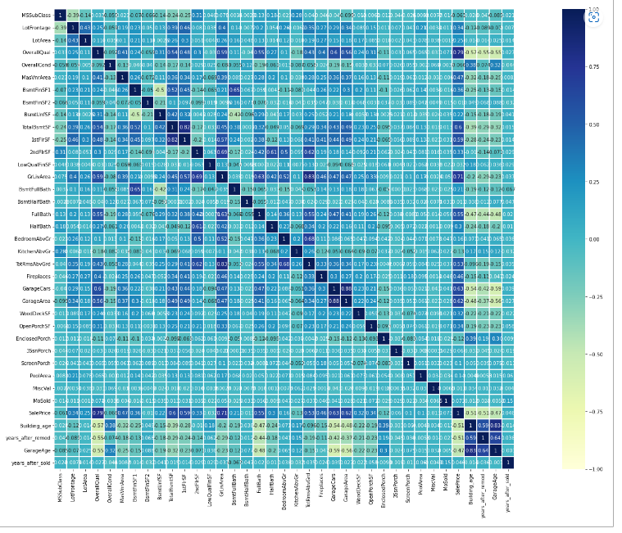
Map for checking the correlation:

Slide 12
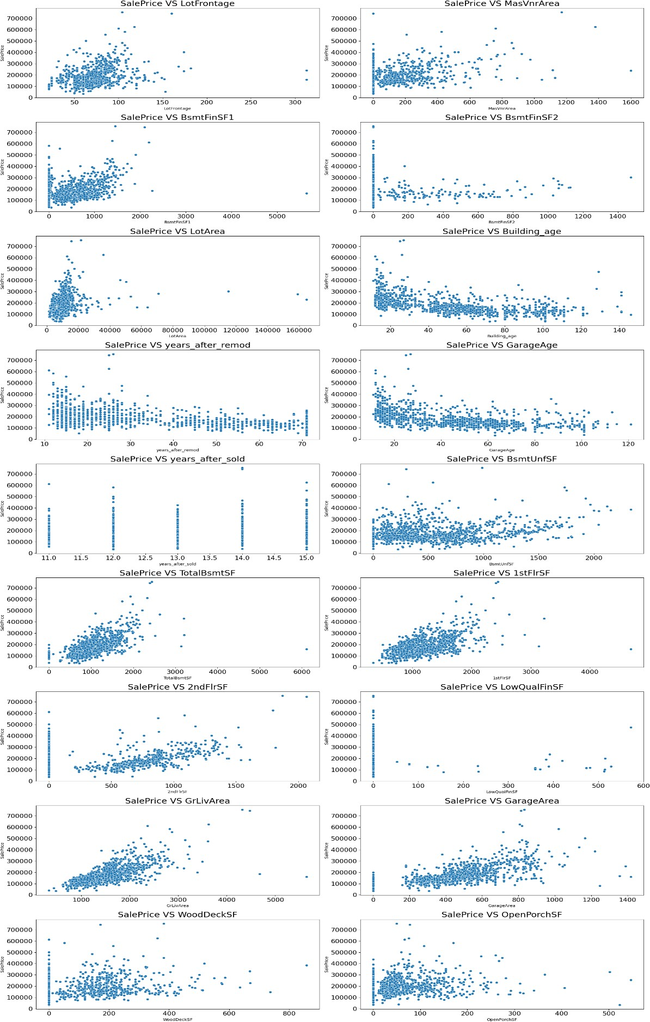
Visualizing Discrete Variables vs Sale Price

Slide 13
Observations
The above scatter plots are showing the relation between some numerical features vs sales price.
If the linear feet of street-connected to the property is more, then the sales price is higher.
The Masonry veneer area increases the price of the house also gets higher.
If the house is with more area of type 1 finished the price is higher.
There are less number of houses with type 2 finish as the area for type two is given zero for most houses.
As the lot size gets higher the price also will increases.
The buildings which have been built long back are having fewer sales price compared to new buildings. Similarly, if Building modification has been done long back then the price is less.
If garages have been built recently the building is having a higher sales price
We can see almost all the buildings have been sold in recent years.
We can see that in most of the cases the Unfinished basement area is below 1000 square feet it will also tell us that the Sales prices will increase as the total basement area increases.
We can see that most houses are having more area on the first floor compared to the second floor And some of the houses are not having rooms on the second floor.
Sales prices increase with the floor area.
We can see most of the houses are with very less area finished with low quality, and also it is observed that more area finished with low quality causes a reduction in sale price.
And as above grade (ground) living area and garage area increases the sale price also increases.

Slide 14
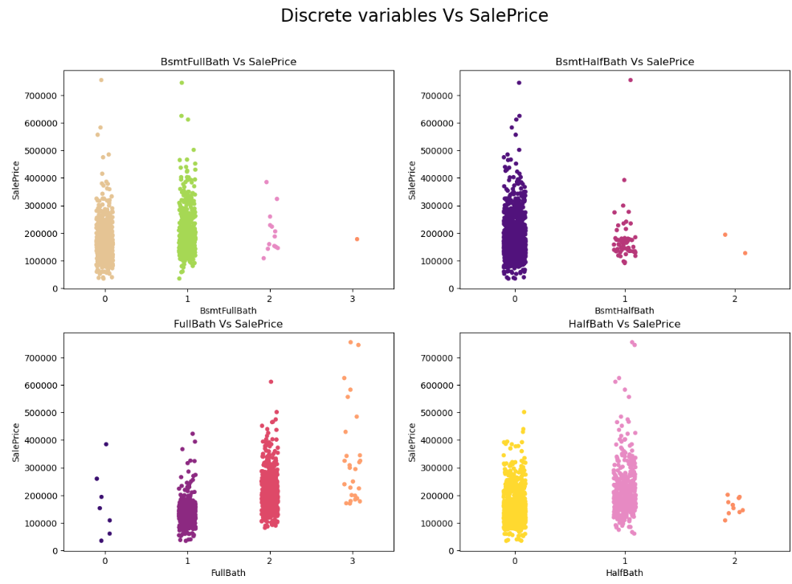
Visualizing Discrete Variables vs Sale Price

Slide 15
Observations
Looking at the above strip plot we can say that more MSSubClass are 20 and 60 and have higher sale prices also.
We can see there is a good linear relation between OverallQual and SalePrice, that is as quality increases the price of the house also gets higher.
Most of the housing data shows basement full bathrooms as 0 and 1, and it seems like the number of basement bathrooms is not affecting our sales price.
Most of the houses are not having basement half bathrooms.
There is some relation is observed between full bathrooms above grade and salePrice. A large count of houses is with 1 - 2 full bathrooms above grade.
Many houses are with zero and 1 half-bathrooms, and very few with 2 half_bathrooms.
A Large number of houses are having 2 to 4 bedrooms and have higher prices. And very few houses are with more than 5 bedrooms which are having a lower price.
Most of the houses are having single kitchens and some houses with two kitchens. The sale price is higher in the case of houses with a single kitchen.
We can observe some linear relation between Total rooms above grade and Sale Prices as the number of rooms increases the price also goes up.
Some houses are not having fireplaces and some are with 1 to 2 fireplaces, very few houses are haveing 3 fireplaces.
Sales price of the house increases with the Size of garage in car capacity. But as the size of the garage increases beyond 3 the price comes down.
We can see that the MoSold column is having the data from every column and it may not have any significant impact on our target variable.

Slide 16
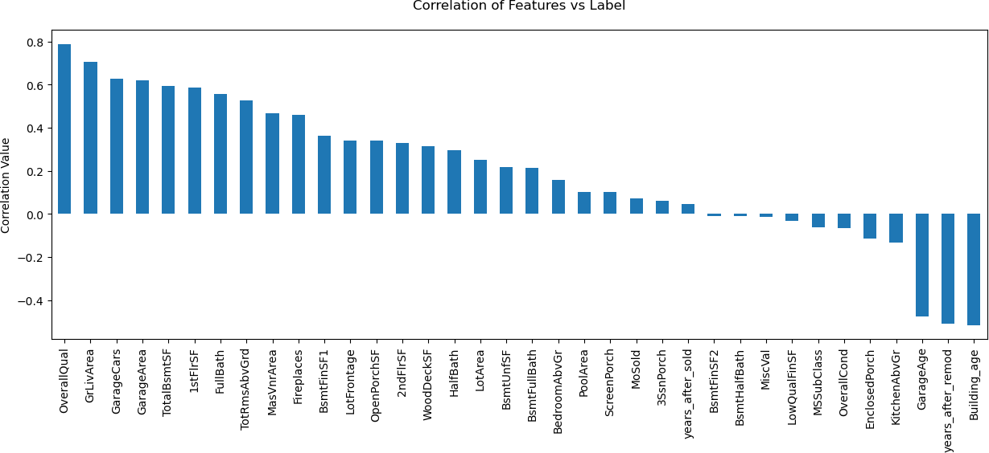
Correlation Between Features and Label

Slide 17
Data Inputs- Logic- Output Relationships
To analyze the relationship between our features and the target variable I have done an EDA to know the contribution of various features to the prediction. And got to know that which are the important features and which are not much. For EDA I have used different plots like distribution plots, scatter plots, box plots, strip plots, heat-map, etc.

Slide 18
Model Building
For this project, we need to predict the prices of houses, which means our target column is continuous so this is a regression problem. I have used various regression algorithms and tested them for prediction. By doing various evaluations I have selected 'XGBoost Regressor model' as the best suitable algorithm for our final model as it is giving good r2-score and the least difference in r2-score and CV-score among all the algorithms used, other algorithms are also giving me better accuracy but some are over-fitting and some are with an under-fitting problem which may be because of less amount of data
For getting good performance as well as accuracy and to check my model from over-fitting and under- fitting I have used KFold cross-validation.
I have used the following algorithms and evaluated them
LinearRegression
DecisionTree Regressor
RandomForest Regressor
XGBRegressor
ExtraTreeRegressor LightGBM
.

Slide 19
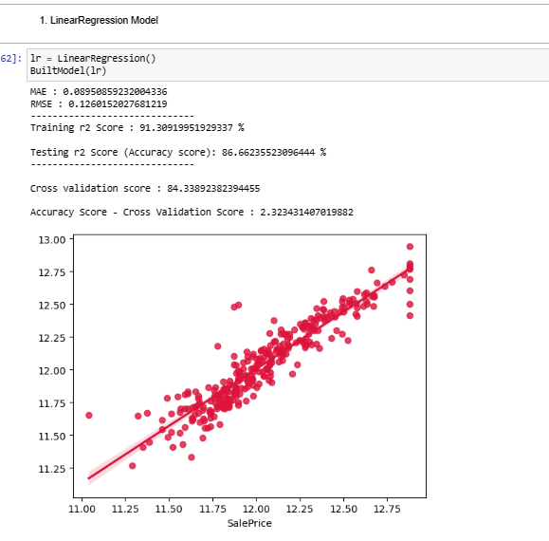
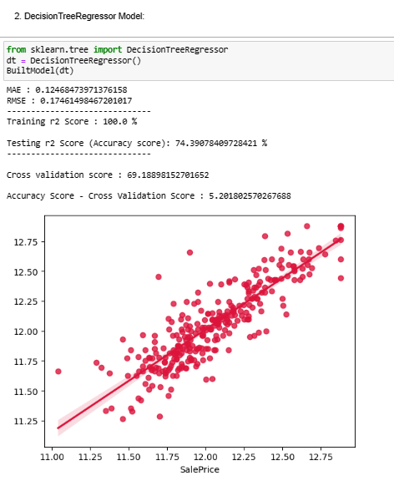
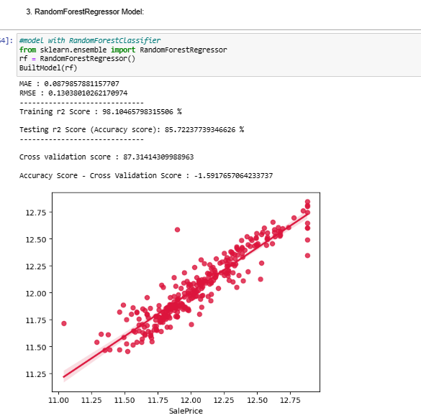
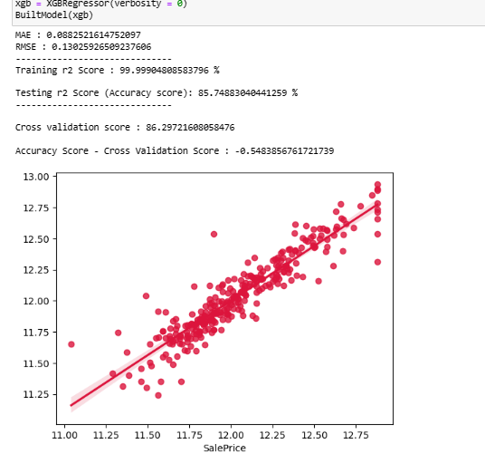
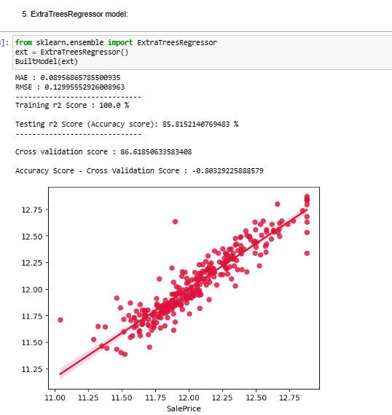
Model Building

Slide 20
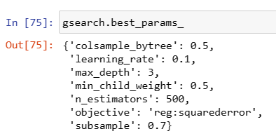
Hyperparameter Tuning
I have done hyperparameter tuning for 'XGBoost Regressor model' for the parameters like 'learning_rate' , ‘max_depth’, 'min_child_weight', 'subsample', 'colsample_bytree', 'n_estimators' and 'objective' using GridSearchCV.
After running the code for the above-mentioned parameters, I got the values that are indicated in the above figure as the best parametric values for our final model.

Slide 21
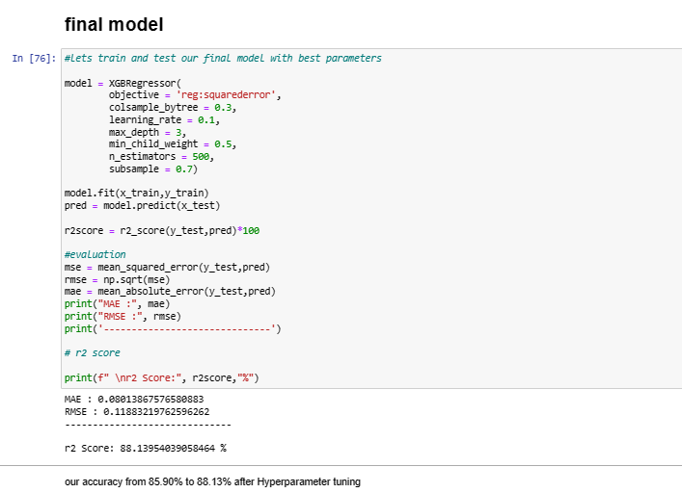
Final modal
Great! We have got improved our accuracy from 85.90% to 88.13% after Hyperparameter tuning

Slide 22
Conclusion
Most of the houses are belong to the Residential Low-Density zone. and many houses from this zone are having higher prices than other zones.
We can observe almost all houses are having paved streets and very few are having gravel streets.
Large numbers of houses are having a General shape of property slightly irregular or regular. very few are having an irregular shape.
Looking at the SalePrice vs LandContour plot we can say that most of the houses are nearly Flat/Leveled.
Almost all houses are with all kinds of utilities.
More number of lots are inside or at corners.
We can see most of the houses are having gentle slopes, and houses with severe slopes are having slightly lower prices.
Houses which are located in Northridge are having more prices compared to other locations.
Looking at the plot for SalePrice vs Condition1 we can see that most houses bear normal conditions.
Looking at the plot for SalePrice vs Condition2 we can see that most houses have normal conditions and very few with other conditions.
Most houses are Single-family Detached and are having higher sale prices than other categories.
Looking at the plot of SalePrice vs HouseStyle we can see that the houses which are having a style of dwelling 1-story and 2-story are had higher prices than other types.

Slide 23
13 Many houses are having roof styles with gable and hip. and a very less number of houses are having shed. 14. Many houses are having roof material as standard (Composite) Shingle and houses with roof material as Standard (Composite) Shingle and Wood Shingles are having higher prices. 15. Many houses are having Vinyl Siding as 1st and 2nd covering on the house and are also having higher prices; houses with hardboard and cement shielding are also having higher prices. 16 We can observe that the houses are with four Masonry veneer types that are, Brick Common, Brick Face, Cinder Block, Stone. Houses with Brick Common are having a lower price. 17. The prices of houses are higher when materials used for the exterior are good or excellent. 18 It is observed that the present conditions of exterior material are mostly average/typical and good and prices for the same are higher. 19. Many houses are having cinder blocks and Poured Concrete foundations and very fewer houses are having wood foundations, houses with Poured Concrete foundations are having higher prices. 20 Basement quality is mostly average or good and the houses with excellent basement quality are having more prices. 21 Most of the houses are having average/Typical basement conditions and very few houses are with poor basement conditions. 22. It seems like basement exposure is not strongly related to the sale price. 23. Most houses are having Heating type as Gas forced warm air furnace and the Sale price of houses 24. are higher whenever the quality of heating is excellent. .

Slide 24
25. Most of the houses with Standard Circuit Breakers & Romex electrical systems and are having higher sale prices as well. Very less number of houses are with Mixed type of electrical systems.
26. Most houses are with good and average kitchen quality, houses are having higher prices when kitchen quality is excellent.
27. Most houses are with typical functionality and a very less number of houses are having severely damaged functionality.
28. In very rare cases fireplace is a prefabricated fireplace in the basement and ben franklin Stove and these houses are having lower prices.
29.. In most of the cases garage is attached to the house only. And when the garage is attached prices are higher and it seems like garage finish does not affect much to sale prices. Most garages are of typical/average quality and conditions.
30 Most of the houses are having paved driveways
31. Many houses are having Sale type of Warranty Deed - Conventional and just constructed and sold and are having higher prices.

Slide 25
Limitations of this work and Scope for Future Work
During this project I have faced the problem of the low amount of data; we can improve the model accuracy with a large amount of data. And many columns are with same entries more than 80% of rows this will lead to a reduction in our model performance.
One more issue is there are a large number of missing values present in this data set, so we have to use correctly fill those missing values.
We can still improve our model accuracy with some feature engineering and by doing some extensive hyper parameter tuning.

Slide 26
Thank YOU

